Slide 1
Analysis of Kansas and Chicago cities crimes on cloud computing
Title of Project:
Analysis of Kansas and Chicago cities crimes on cloud computing.
Team members:
Shwel Alshehri (The entire work).

Slide 2
Analysis of Kansas and Chicago cities crimes on cloud computing
Motivation:
1.Safety.
2. service availability.
3. Help people who make studies on crimes and criminal behaviors.

Slide 3
Analysis of Kansas and Chicago cities crimes on cloud computing
Objectives:
Building website which can provides analysis of Kansas and Chicago Cities crimes in many and different classes (such as age, place and time) through the Internet.

Slide 4

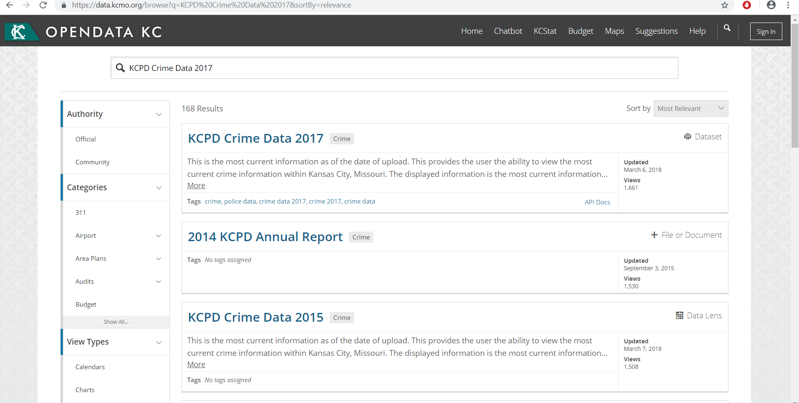

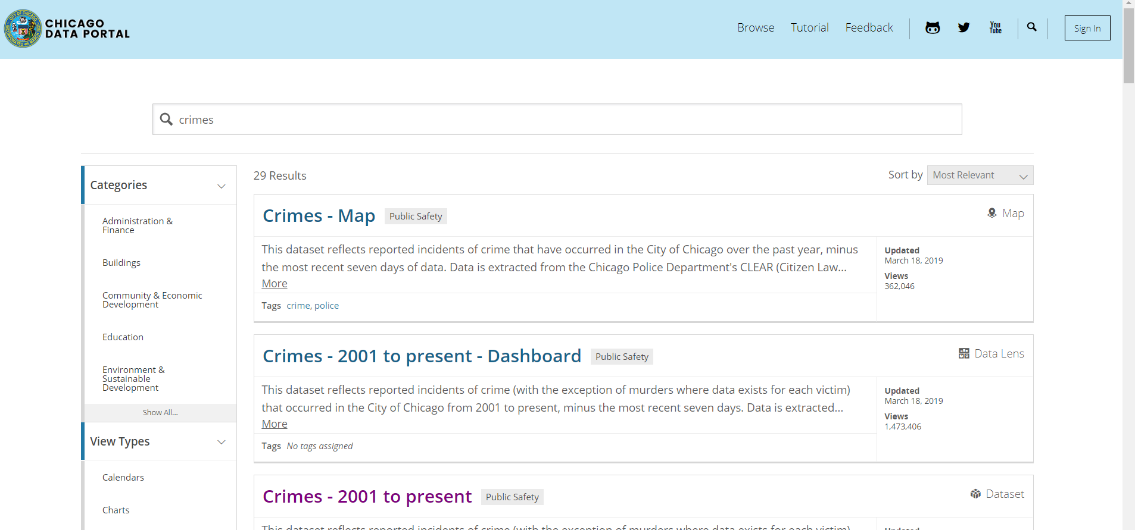
Analysis of Kansas and Chicago cities crimes on cloud computing
My data
Classify the data on different classes
(age-place-time…….)
Reorganize the data.
Add maybe some feature.
Visualize the data :
Tools: tableau software, Infogram
Charts ,maps

Slide 5
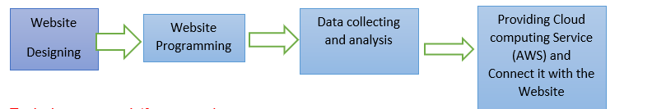
Analysis of Kansas and Chicago cities crimes on cloud computing
Block Diagram

Slide 6
Analysis of Kansas and Chicago cities crimes on cloud computing
Tools, languages, platforms, used:
Using Html and Php to build the website. Using AWS to store and share the analysis of data through the internet.
tableau software, Infogram to Visualize the data .

Slide 7
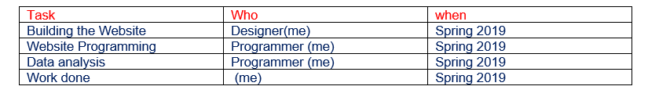
Analysis of Kansas and Chicago cities crimes on cloud computing
Implementation:

Slide 8
Analysis of Kansas and Chicago cities crimes on cloud computing
Expected project outcome:
The ability to design, program new websites.
Dealing with cloud computing services and their issues.
Learning new technologies.
Individual learning outcome:
learning and training about cloud computing projects.( how to create , deal with issues).

Slide 9
Analysis of Kansas and Chicago cities crimes on cloud computing
Thank you

